Slide 1


Data Analysis Using
Python
Lecture-3
www.bennett.edu.in
www.bennett.edu.in

Slide 2
Loading Python Libraries
2
#Import Python Libraries import numpy as np import scipy as sp import pandas as pd import matplotlib as mpl import seaborn as sns
In [
]:
Press Shift+Enter to execute the jupyter cell
www.bennett.edu.in

Slide 3
Reading data using pandas
3
In [ ]:#Read csv file
df = pd.read_csv("Salaries.csv")
Note: The above command has many optional arguments to fine-tune the data import
process.
The file salaries can be download from https://drive.google.com/file/d/1wAp7aodlSfea1_5aquTWyE_3abs0CeJ5/view?usp=sh aring
There is a number of pandas commands to read other data formats: pd.read_excel('myfile.xlsx',sheet_name='Sheet1', index_col=None, na_values=['NA'])
pd.read_stata('myfile.dta') pd.read_sas('myfile.sas7bdat')
pd.read_hdf('myfile.h5','df')
www.bennett.edu.in

Slide 4
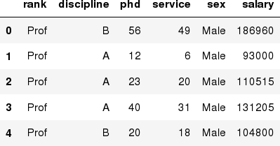
Exploring data frames
4
In [3]:#List first 5 records
df.head()
Out[3]:
www.bennett.edu.in

Slide 5

Hands-on exercises
5
Try to read the first 10, 20, 50 records;
Can you guess how to view the last few records;
Hint:
www.bennett.edu.in

Slide 6
Data Frame data types
6
Pandas Type | Native Python Type | Description
object | string | The most general dtype. Will be assigned to your column if column has mixed types (numbers and strings).
int64 | int | Numeric characters. 64 refers to the memory allocated to hold this character.
float64 | float | Numeric characters with decimals. If a column contains numbers and NaNs(see below), pandas will default to float64, in case your missing value has a decimal.
datetime64, timedelta[ns] | N/A (but see the datetime module in Python’s standard library) | Values meant to hold time data. Look into these for time series experiments.
www.bennett.edu.in

Slide 7
Data Frame data types
7
In [4]:#Check a particular column type
df['salary'].dtype
Out[4]: dtype('int64')
In [5]:#Check types for all the columns
df.dtypes
Out[4]:_{rank}
discipline phd service sex salary
dtype: object
object object int64 int64 object int64
www.bennett.edu.in

Slide 8
Data Frames attributes
8
Python objects have attributes and methods.
df.attribute | description
dtypes | list the types of the columns
columns | list the column names
axes | list the row labels and column names
ndim | number of dimensions
size | number of elements
shape | return a tuple representing the dimensionality
values | numpy representation of the data
www.bennett.edu.in

Slide 9
Hands-on exercises
9
Find how many records this data frame has;
How many elements are there?
What are the column names?
What types of columns we have in this data frame?
www.bennett.edu.in

Slide 10

Data Frames methods
10
https://www.w3schools.com/python/pandas/ref_df_describe.asp
Unlike attributes, python methods have parenthesis.
All attributes and methods can be listed with a dir() function: dir(df)
df.method() | description
head( [n] ), tail( [n] ) | first/last n rows
describe() | generate descriptive statistics (for numeric columns only)
max(), min() | return max/min values for all numeric columns
mean(), median() | return mean/median values for all numeric columns
std() | standard deviation
sample([n]) | returns a random sample of the data frame
dropna() | drop all the records with missing values
www.bennett.edu.in

Slide 11
Hands-on exercises
11
Give the summary for the numeric columns in the dataset
Calculate standard deviation for all numeric columns;
What are the mean values of the first 50 records in the dataset? Hint: use head() method to subset the first 50 records and then calculate the mean
www.bennett.edu.in

Slide 12
Selecting a column in a Data Fr
12
Method 1:
Subset the data frame using column name: df[‘discipline']
Method 2:
Use the column name as an attribute: df.discipline
Note: there is an attribute rank for pandas data frames, so to select a column with a name "rank" we should use method 1.
www.bennett.edu.in

Slide 13
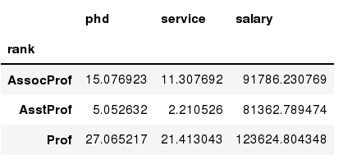
Data Frames groupby method
13
Using "group by" method we can:
Split the data into groups based on some criteria
Calculate statistics (or apply a function) to each group
In [ ]:#Group data using rank
df_rank = df.groupby(['rank'])
In [ ]:#Calculate mean value for each numeric column per each group
df_rank.mean()
www.bennett.edu.in

Slide 14
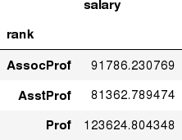
Data Frames groupby method
14
Once groupby object is created we can calculate various statistics for each
In #C: alculate mean salary for each professor rank:
df.groupby('rank')[['salary']].mean()
Note: If single brackets are used to specify the column (e.g. salary), then the output is Pandas Series object. When double brackets are used the output is a Data Frame
www.bennett.edu.in

Slide 15
Data Frames groupby method
15
groupby performance notes:
no grouping/splitting occurs until it's needed. Creating the groupby
object only verifies that you have passed a valid mapping
by default the group keys are sorted during the groupby operation. You may want to pass sort=False for potential speedup:
In [ ]:#Calculate mean salary for each professor rank:
df.groupby(['rank'], sort=False)[['salary']].mean()
www.bennett.edu.in

Slide 16
Data Frame: filtering
16
To subset the data we can apply Boolean indexing. This indexing is commonly known as a filter. For example if we want to subset the rows in which the salary value is greater than $120K:
In [ ]:#Calculate mean salary for each professor rank:
df_sub = df[ df['salary'] > 120000 ]
Any Boolean operator can be used to subset the data:
> greater;
< less;
>= greater or equal;
<= less or equal;
!= not equal;
== equal;
In [ ]:#Select only those rows that contain female professors:
df_f = df[ df['sex'] == 'Female' ]
www.bennett.edu.in

Slide 17
Data Frames: Slicing
17
There are a number of ways to subset the Data Frame:
one or more columns
one or more rows
a subset of rows and columns
Rows and columns can be selected by their position or label
www.bennett.edu.in

Slide 18
Data Frames: Slicing
18
When selecting one column, it is possible to use single set of brackets, but the resulting object will be a Series (not a DataFrame):
In [ ]:#Select column salary:
df['salary']
When we need to select more than one column and/or make the output to be a DataFrame, we should use double brackets:
In [ ]:#Select column salary:
df[['rank','salary']]
www.bennett.edu.in

Slide 19
Data Frames: Selecting rows
19
If we need to select a range of rows, we can specify the range using ":"
In [ ]:#Select rows by their position:
df[10:20]
Notice that the first row has a position 0, and the last value in the range is omitted:
So for 0:10 range the first 10 rows are returned with the positions starting
with 0 and ending with 9
www.bennett.edu.in

Slide 20
www.bennett.edu.in

